Slide 1
JAVA
Java is general purpose object-oriented programming language developed by Sun Microsystems of USA in 1991.
Java was designed for the development of software for consumer electronic devices like TVs, VCRs,and other electronic machines.
It has removed those features of C/C++ that were considered as sources of problems and thus made java a really simple, reliable, portable, and powerful language.

Slide 2
  Features of Java
  Compiled and Interpreted
  Platform-Independent and Portable
  Object-Oriented
  Robust and Secure
  Distributed
  Simple, Small and Familiar
  Multithreaded and Interactive
  High Performance
  Dynamic and Extensible

Slide 3
JDK Editions
Java Standard Edition (J2SE)
– J2SE can be used to develop client-side standalone
applications or applets.
Java Enterprise Edition (J2EE)
– J2EE can be used to develop server-side appli. such as
        Java servlets
        Java Server Pages.
Java Micro Edition (J2ME)
– J2ME can be used to develop applications for mobile
devices such as cell phones.

Slide 4
1. Java, J2SE, JSDK, JDK, JRE
There are several 'Java' names:
  Java is the name of the language
    Java 2 is the current version
  the language + tools (e.g. compiler) is called J2SE, the Java 2 Standard Edition
    J2SE 1.5.0. is the current version
    its also known as J2SE 5.0
the same
thing

Slide 5
There are two version of J2SE which contain different amounts of tools:
  JSDK: the full version
  JRE: just enough tools to run already compiled programs

Slide 6
JSDK
  stands for "Java Software Development Kit
  JDK is the old name for JSDK
  don't be surprised to also see J2SDK
  or Java SDK

Slide 7
Java History
1 Jdk 1.0 (January 23, 1996) (Unsupported)
2 Jdk 1.1 (February 19, 1997) (Unsupported)
3 J2se 1.2 (December 8, 1998) (Unsupported)
4 J2se 1.3 (May 8, 2000) (Unsupported)
5 J2se 1.4 (February 6, 2002) (Eol)
6 J2se 5.0 (September 30, 2004) (Eol)
7 Java Se 6 (December 11, 2006) (Supported)
  7.1 Java Se 6 Update 10
8 Java Se 7

Slide 8
JAVA and C
Java does not include the C unique statement keywords sizeof and typedef.
Java does not contain the data types struct and union.
Java does not define the type modifiers keywords auto, extern, register, signed, and unsigned.
Java does not support an explicit pointer type.
Java does not have a preprocessor and therefore we cannot use #define, #include, and #ifdef statements.
Java adds new operators such as instanceof >>>.

Slide 9
Java and C++
Java is a true object-oriented language while C++ is basically C with object-oriented extension .
Java does not support operator overloading.
Java does not support multiple inheritance of classes. This is accomplished using a new features called “interface”.
Java does not support global variable. Every variable and method is declared within a class and forms part of that class.
Java does not use pointers.
Java has replaced the destructor function with a finalize() function.
There is no header file in Java.

Slide 10
Java Program Structute
Documentation Section
Package Statement
Import Statements
Interface Statements
Class Definitions
Main method class
{
Main method definition
}
yogesh_84kumar@yahoo.com

Slide 11
Implementing the Java Program
Creating the Java Program
Compiling the Program
Running the Program

Slide 12
JAVA Virtual Machine
Source Program Byte Code
Virtual Machine Real Machine
Java Program
Java Compiler
Virtual Machine
Bytecode
Java Interpreter
Machine Code

Slide 13
Data Types
Java has two main categories of data types:
  Primitive data types
    Built in data types
    Many very similar to C++ (int, double, char, etc.)
    Variables holding primitive data types always hold the actual value, never a reference
  Reference data types
    Arrays and user defined data types (i.e. Classes, Interfaces)
    Can only be accessed through reference variables

Slide 14
Primitive Data Types
Integer data types
  byte – 8 bits (values from -128 to +127)
  short – 16 bits (-32768 to +32767)
  int – 32 bits (very big numbers)
  long – 64 bits (even bigger numbers)
Characters
  char – 16 bits, represented in unicode, not ASCII!
Floating point data types
  float – 4 bytes (-3.4 x 10³⁸ to +3.4 x 10³⁸)
  double – 8 bytes (-1.7 x 10³⁰⁸ to 1.7 x 10³⁰⁸)
Boolean data
  boolean
    can only have the value true or false
    Unlike C++, cannot be cast to an int (or any other data type)

Slide 15
Operators
Arithmetic
  +,-,*,/,%,++,--
Logic
  &,|,^,~,<<,>>,>>>
Assignment
  =, +=, -=, etc..
Comparison
  <,<=,>,>=,==,!=
Work just like in C++, except for special String support

Slide 16
Control Structures
if/else, for, while, do/while, switch
Basically work the same as in C/C++
i = 0;
while(i < 10) {
a += i;
i++;
}
for(i = 0; i < 10; i++) {
a += i;
}
if(a > 3) {
a = 3;
}
else {
a = 0;
}
switch(i) {
case 1:
string = “foo”;
case 2:
string = “bar”;
default:
string = “”;
}
i = 0;
do {
a += i;
i++;
} while(i < 10);

Slide 17
Control Structures
Java also has support for continue and break keywords
Again, work very similar to C/C++
Also note: switch statements require the condition variable to be a char, byte, short or int
for(i = 0; i < 10; i++) {
a += i;
if(a > 100)
break;
}
for(i = 0; i < 10; i++) {
if(i == 5)
continue;
a += i;
}

Slide 18
Working With Java Objects
Encapsulation
Inheritance
Polymorphisms
Constructors
Garbage Collection and Finalize

Slide 19
Method Overloading
In java, it is possible to create methods that have the same name, but different parameter lists and diffrerent definitions. This is called method overloading.
Method overloading is used when objects are
required to perform similar tasks but different input parameters.

Slide 20
Can we overload java main() method?
Yes, by method overloading. You can have any number of main methods in a class by method overloading. But JVM calls main() method which receives string array as arguments only. Let's see the simple example:
class TestOverloading4{
public static void main(String[] args){System.out.println("main with String[]");}
public static void main(String args){System.out.println("main with String");}
public static void main(){System.out.println("main without args");}
}

Slide 21
Array in Java
Normally, an array is a collection of similar type of elements which has contiguous memory location.
Java array is an object which contains elements of a similar data type. Additionally, The elements of an array are stored in a contiguous memory location. It is a data structure where we store similar elements. We can store only a fixed set of elements in a Java array.
Unlike C/C++, we can get the length of the array using the length member. In C/C++, we need to use the sizeof operator.
Types of Array in java
There are two types of array.
Single Dimensional Array
Multidimensional Array

Slide 22
Array in Java
Single Dimensional Array in Java
Syntax to Declare an Array in Java
dataType[] arr; (or)
dataType []arr; (or)
dataType arr[];
Instantiation of an Array in Java
arrayRefVar=new datatype[size];

Slide 23
Array in Java
//Java Program to illustrate how to declare, instantiate, initialize
//and traverse the Java array.
class Testarray{
public static void main(String args[]){
int a[]=new int[5];//declaration and instantiation
a[0]=10;//initialization
a[1]=20;
a[2]=70;
a[3]=40;
a[4]=50;
//traversing array
for(int i=0;i<a.length;i++)//length is the property of array
System.out.println(a[i]);
}}

Slide 24
Declaration, Instantiation and Initialization of Java Array
We can declare, instantiate and initialize the java array together by:
int a[]={33,3,4,5};//declaration, instantiation and initialization
class Testarray1{
public static void main(String args[]){
int a[]={33,3,4,5};//declaration, instantiation and initialization
//printing array
for(int i=0;i<a.length;i++)//length is the property of array
System.out.println(a[i]);
}}

Slide 25
For-each Loop for Java Array
We can also print the Java array using for-each loop. The Java for-each loop prints the array elements one by one. It holds an array element in a variable, then executes the body of the loop.
The syntax of the for-each loop is given below:
for(data_type variable:array){
//body of the loop
}

Slide 26
Example for For-each Loop
//Java Program to print the array elements using for-each loop
class Testarray1{
public static void main(String args[]){
int arr[]={33,3,4,5};
//printing array using for-each loop
for(int i:arr)
System.out.println(i);
}}

Slide 27
Java Math class
Java Math class provides several methods to work on math calculations like min(), max(), avg(), sin(), cos(), tan(), round(), ceil(), floor(), abs() etc.
public class JavaMathExample1
{
public static void main(String[] args)
{ double x = 28;
double y = 4;
// return the maximum of two numbers
System.out.println("Maximum number of x and y is: " +Math.max(x, y));
// return the square root of y
System.out.println("Square root of y is: " + Math.sqrt(y));

Slide 28
Java Math class
//returns 28 power of 4 i.e. 28*28*28*28
System.out.println("Power of x and y is: " + Math.pow(x, y));
// return the logarithm of given value
System.out.println("Logarithm of x is: " + Math.log(x));
System.out.println("Logarithm of y is: " + Math.log(y));
// return the logarithm of given value when base is 10
System.out.println("log10 of x is: " + Math.log10(x));
System.out.println("log10 of y is: " + Math.log10(y));

Slide 29
Java Math class
// return the log of x + 1
System.out.println("log1p of x is: " +Math.log1p(x));
// return a power of 2
System.out.println("exp of a is: " +Math.exp(x));
// return (a power of 2)-1
System.out.println("expm1 of a is: " +Math.expm1(x));
}
}

Slide 30
Method Overriding
You can override any method of the base class by declaring the method in your subclass with the same signature (same return type, method name, and parameter list)
If you have overridden a base class method and wish to access the base class version of it, you can again use the super keyword
class SubClass extends BaseClass{
…
public String baseMethod() {
return super.baseMethod() + “\n”;
}
}

Slide 31
Interface in Java
Java does not support multiple inheritance as C++ supports
Java supports an alternative approach to this OOP feature known as interface
What is Interface?
  An interface is basically a kind of class. Like classes, an interface contains members and methods; unlike classes, in interface all members are final and all methods are abstract

Slide 32
Syntax for Defining an Interface
Following is the syntax to define an Interface
interface interfaceName [extends name1, ..... ]
{
  [ Variable(s) declaration;]
  [ Method(s) declaration;]
}
Variable in interface is declared as:
static final type varName = value;
Method in interface is declared as:
Retun-type methodName(parameter list);

Slide 33
Defining an Interface: Examples
Example 1
  interface anItem
  {
    static final int code = 101;
    static final String itemName = “Computer”
    void recordEntry( );
  }
Example 2
  interface curves extends circle, ellipse
  {
    static final float pi = 3.142F;
    float area(int a, int b);
    void print( );
  }

Slide 34
Implementation of classes with Interface
Syntax
class className [extends superClassName]
{
  [implements interfaceName1, interfaceName2, ...]
  {
    Class body
  }

Slide 35

Packages in Java
Code reusability is the main philosophy of Object Oriented Programming
To power this advantage, Java has a number of packages called API bundled with the JDK
Packages are collection of classes and interfaces to facilitate a number of ready made solutions
A great knowledge of packages helps the Java developer to master in Java solution
In addition to the API, user can maintain their own packages

Slide 36
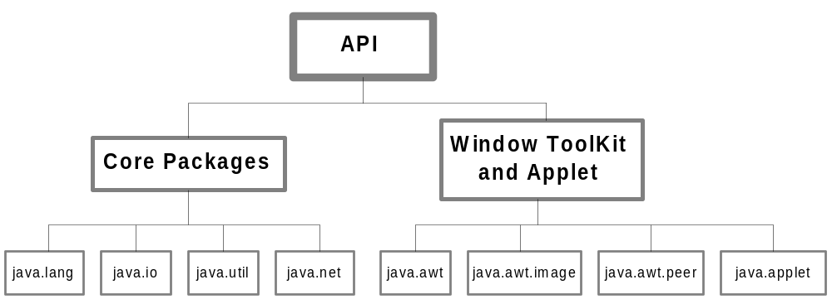
API – The Built-in Java Packages

Slide 37

Using API Packages
A package is a collection of classes and each class is a collection of members and methods.
Any class as well as any member and method in a package are accessible from a Java program
This can be achieved in Java by import statement
There are two ways of using import statement
  With fully quantified class name
    When it is required to access a particular class
    Example: java.lang.String
  With default (.*) quantification
    When it is required to access a number of classes
      Example: java.lang.*

Slide 38

Using API Packages (Contd..)
However, instead of importing whole package or a class it is possible to refer a class in order to instantiate an object
Example
  java.util.Date toDay = new java.util.Date ( );
  System.out.println(toDay);
The same thing but with import statement can be done as follows
  import java.util.Date;
  Date today = new Date( );
  System.out.println(toDay);

Slide 39

User Defined Packages
User can maintain their own package. The package statement can be used for the purpose with the following syntax
package myPackage
public Class myClass {
    . . .
    . . .
  }
  Here, myPackage is the name of the package and it contains the only class myClass

Slide 40
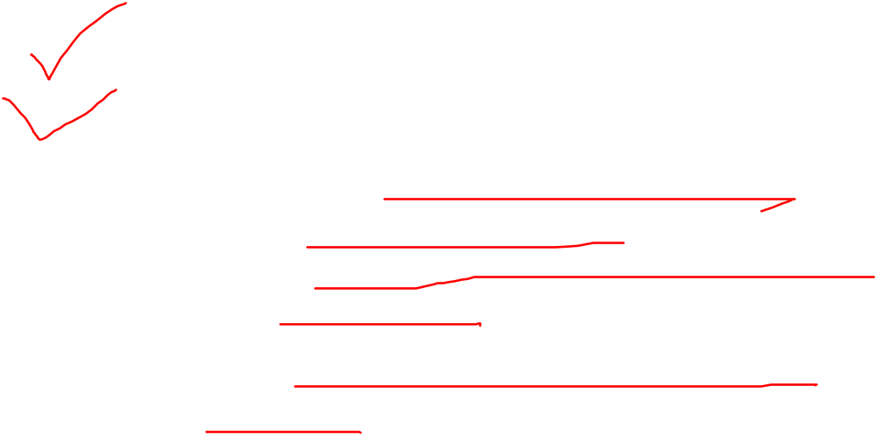
User Defined Packages (contd..)
In addition to this following steps must be taken into consideration
  Use package statement at the beginning of the package file
  Define the class that is to be put in the package and declare it as public
  Create a subdirectory under the working directory with the same name as the package name
  Store the file with the same name as the className.java in the subdirectory created
  Store the compile version (i.e. .class) file into the same subdirectory

Slide 41

User Defined Packages: Example
// User defined package
package MyPackage;
public class MyClass {
public void test ( ) {
System.out.println ( " Welcome to My Class !");
}
}
// Import the package with the following code.
import MyPackage.MyClass;
class PackageTestAppln {
public static void main ( String args [ ] ) {
MyClass theClass = new MyClass ( );
theClass.test ( );
}
}

Slide 42
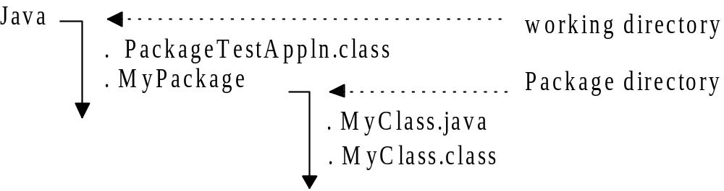
User Defined Packages: Example (contd..)

Slide 43

More on: User Defined Packages
Note
  We cannot put two or more public classes together in a .java file; otherwise there will be an ambiguitu in naming the .java file
? How a package then contains multiple classes
Solution
package P
public class A {
. . .
}
package P
public class B {
. . .
}
Steps
Create a directory named P
Store the class A in the file A.java in it
Comiple A.java and place it in the directory P
Store the class A in the file A.java in it
Comiple A.java and place it in the directory P
import P.*;
will import all classes in the package P!

Slide 44

More on: User Defined Packages
Note
  We cannot put two or more public classes together in a .java file; only public classes are accessible from the outside of the package
? How a non-public package will be in use
Solution
Hiding a class in a package
Toprevent a class to be accessed from a package define it as non-public.
The non-public class can be seen and used only by other classes in the same package
More than one non-public class can be put together in one .java file provided that this file has a unique public class
import P.*;
will import all classes in the package P except non-public classes!
package P
public class A {
. . .
}
package P
class B {
. . .
}

Slide 45

Binding in Java
Binding refers to the linking of a method or member to the code to be executed in response to a reference
Java supports two types of binding, which makes a Java program robust and allows better way of code sharing
  Static binding
    Here, the reference can be understood from the program structure itself
  Dynamic binding
    Here, a reference can be decided at runtime, that is, dynamically

Slide 46

Static Binding in Java
In general, each instance of a class has its own copy of any members and methods.
However, it is possible to designate a member or method as belonging to that class itself independent of any object of that class.
Such a static binding can be enforced using the keyword static
Static variable just behalves like as global variable
Static method thus remains invariant for any instantiation

Slide 47

Static Binding in Java: Example
class StaticClass {
static int count;
StaticClass ( ) {
count ++ ;
}
public static void printCount ( ) {
System.out.println ( " Count = " + count );
}
class StaticTest {
count = 0;
public static void main ( String args [ ] ) {
StaticClass x, y;
x.printCount ( ) ;
y.printCount ( ) ;
StaticClass.printCount ( );
x = new StaticClass ( );
printCount ( ) ; y = new StaticClass ( ) ; printCount ( ) ;
}
}

Slide 48
Dynamic Binding in Java
The dynamic binding is resolved during the execution time
In this binding, the reference of a variable or method is resolved from the most recent instance of the object.
The default binding in Java is dynamic binding

Slide 49
Dynamic Binding in Java: Example
class A {
void callMe ( ) {
System.out. println ( " I am from A ") ;
}
}
class B extends A {
void callMe ( ) {
System.out.println ( " I am from B ");
}
}
class Who {
public void static main (String args [ ] ) {
A a = new B ( ) ;
a.callMe ( );
}
}

Slide 50
Exception Handling
Types Of Error:
Compile-Time Error
Run-Time Error
Exceptions: An exception is a condition that is caused by a run-time error in the program.
When the Java interpreter encounters an error such as dividing an integer by Zero, It creates an Exception object and throws.
Types Of Exception.
Syntax of Exception Handling Code.

Slide 51
other Exceptions Topics
Multiple Catch Statements
Nested Try statements
Using Finally Statement

Slide 52
Multithreading
Multithreading: Multithreading is a conceptual programming paradigm where a program is divided into two or more subprograms, which can be implemented at the same time in parallel.
Thread: A thread is similar to a program that has a single flow of control. It has a beginning, a body, and an end, and executes commands sequentially.
It is important to remember that “thread running in parallel” does not really means that they actually shared b/w the threads.

Slide 53
Multithreading topics
Creating Threads
Extending the thread class
a) Declare the class as extending the thread class.
b) Implement the run() method.
c) Starting New Thread
Stopping and Blocking a thread

Slide 54
Life Cycle of a Thread
Newborn State
Runable State
Running State
Blocked State
Dead State

Slide 55
Thread Priority
In java, each thread is assigned a priority, which affects the order in which it is scheduled for running.
The thread of the same priority are given equal treatment by the java scheduler.
ThreadName.setPriority(int Number);
int number is an integer value to which the thread’s priority is set.
MIN_PRIORITY =1
NORM_PRIORITY =5
MAX_PRIORITY =10
Default setting is NORM_PRIORITY =5

Slide 56
Use of isAlive() and Join() method in thread
isAlive( ) :- returns true if the thread upon which it is called is still running. Otherwise, it will returns false.
Join( ):- the method we use to wait for thread to finish.
final void join( ) throws InterruptException

Slide 57
Event Handling
Events are supported by a number of packages, including java.util, java.awt and java.awt.event.
Most Events to which your program will respond are generated when the user inracts with a GUI-based program.

Slide 58
The Dalegation Event Model
It is a modern approach to handling an events.
It defines standard and consistent mechanisms to generate and the process events.
The Concept is:
a) A source generates an event and sends it to one or more listeners.
b) And the listeners simply waits until it receives an event. Once an event is received, the listener processes events and then returns.

Slide 59
The Delegation Event Model
Events: In Delegation Model, an event is an object that describes a state changes in a source.
Event Source: A source is an object that generates an event. A source may generates more than one type of event.
Event Listeners: A listener is an object that is notified when event occurs.

Slide 60
Event Classes
The Acton Event Class
The AdjustmentEvent Class
ComponentEvent
ContainerEvent
FocusEvent
InputEvent
ItemEvent
MouseEvent
TextEvent
WindowEvent

Slide 61
Applet Programming
Applet are small java program that are primarily used in Internet Computing. They can be transported over the internet from one computer to another and run using the Applet Viewer or any other Web browser that support java.
Local Applet:- An applet developed locally and stored in a local system is known as a local Applet.
Remote Applet:- is developed by someone else and stored on a remote computer connected to the internet.

Slide 62
How Applet Different from Applications
Applets are not fully-featured programs. They are usually written to accomplish a small task.
Applets do not use main( ) method for initiating the execution of the code.
Applets can not be run independently.
Applets can not read from or write to the files in the local computer.
Applets cannot communicate with other servers on the network.
Applets can not run any program from the local computer.

Slide 63
Perparing to write Applets
Building an applet code (.java file)
Creating an executable applet (.class file)
Designing a Web pages using HTML tags
Perparing <APPLET> tag
Incorporating <APPLET> tag into the web page.
Creating HTML file
Testing the applet code

